Slide 1


Reberry Juice Bar Website
Jacqueline Rios
Information architecture
Dr. Vanessa Reyes
Notes:
Hello, welcome to the final presentation of the information architecture for the Reberry Juice Bar Website.

Slide 2
Executive Summary
Present information about the website - Reberry Juice Bar
Present research in the form of missions and goals
Present solutions through visuals
Discuss issues and lessons learned
Notes:
A summary of the upcoming content initiates with
A Presentation of information about the website - Reberry Juice Bar
A Presentation of research in the form of missions and goals
A Presentation of solution through visuals
And discussion of issues and lessons!

Slide 3
Reberry Juice Bar Summary
What the website provides:
Information about the store
A menu for browsing that includes nutritional information.
online ordering for in store pick up
Rewards account to incentivise and award customers
Notes:
The Reberry Juice Bar provides :
Information about the store including location, and contact information, etc.
A menu for browsing that includes nutritional information for each item.
Allowing online order for in store pick up
Access to a personal rewards account for customers to accumulate and redeem points from their purchases for their desired items. It helps establish customer loyalty and give back to its community

Slide 4
Mission and Goals
Website’s Mission:
An accessible platform for Reberry Juice Bar’s services specializing in serving healthy foods to support a healthier and happier lifestyle in underserved communities.
First Goal: Conduct research on potential clients, customers and general visitors.
Notes:
The website provides this content with a mission is to create an accessible platform for Reberry Juice Bar’s services specializing in serving healthy foods to support a healthier and happier lifestyle in underserved communities.
First Goal: Conduct research on potential clients, customers and general visitors.
In order to achieve an accessible, efficient website, also taking into consideration user’s goals and needs is critical. User research assists in discovering diverse primary users’ information needs. Implementing their goals and needs into the design help achieve our mission of a website accessible to them.
This is achieved with user personas and user scenarios.

Slide 5
Mission and Goals Continued
Second Goal:
Plan out how the website’s contents will be grouped and draft visuals of diverse pages
Third Goal:
Solidify the plan by demonstrating specific and carefully designed representation of website’s pages, links, features, and navigation:
Fourth Goal:
Present the reasoning behind the design and why it is befitting of both the clients and customers needs
Notes:
Second Goal: Plan out how the website’s content will be grouped and draft visuals of diverse pages.
Initiates how to organize and structure the content needed and its flow. This is achieved with low fidelity wireframes.
Third Goal: Solidify the plan by demonstrating specific and carefully designed representation of website’s pages, links, features, and navigation.
It portrays the final blueprints and how the website will function to stakeholders.
This is achieved with the high-fidelity wireframes.
Fourth Goal: Present the reasoning behind the design and why it is befitting of both the clients and customers needs.
Helps assess and reassure how well the website achieves its intended missions and goals.
Incorporated commentary describing the decisions made for the high-fidelity wireframes.

Slide 6
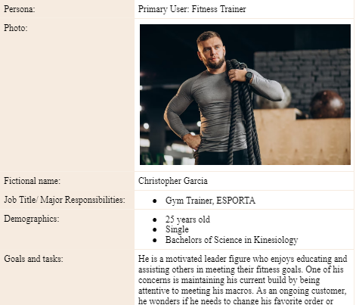
First Goal: User scenarios
User Personas: | User Scenarios: Garcia is in line at the busy Juice Bar and is trying to figure out what item to get before he gets to make his order. He just got out of the gym and still hasn’t met his protein macros for the day. He has tried most of the protein shakes, but is craving the more filling bowls for once. Not knowing what bowl seems most enticing to him, and which bowl could help him get some more protein intake, he has a few inquiries in mind. Instead of waiting to ask for information from the stressed out cashier, he wants to assess his choices by visiting their website.
Notes:
Considering the diverse perspective of potential customers really assisted me in considering what type of information the website will need, how much, and how to make it easy to access. In this case, I developed a user persona and user scenario of a user that is well versed in fitness and his health. He would want to ensure the item he chooses meets the specific macros he needs for the day. This helped validate the need of nutrition of items as a helpful chunk of information on my website. Trying to think of this user’s steps to reach this information helps consider what to plan for flow later.

Slide 7
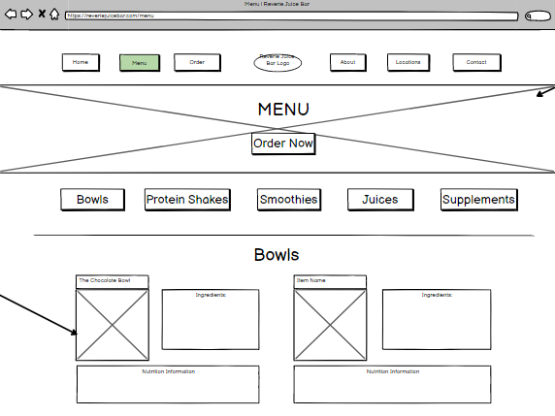
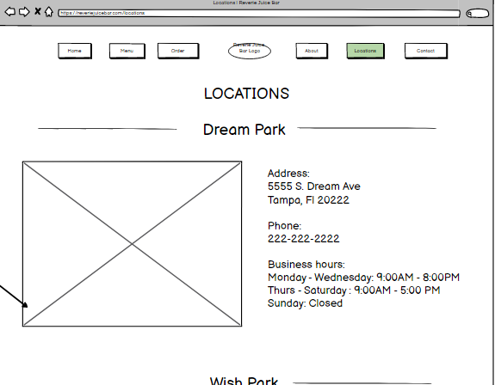
Second Goal : Low fidelity Wireframes
Notes:
Making a low fidelity wireframe helped discover initial plans for organizing the content and their navigation needed plenty of revision. For example, my menu would show a lot of content at a glance. Not everyone would want to see nutrition, or ingredients. But just because some won’tt doesn’t mean I should not include it. It is important to keep this information within a page. since the business’s mission is to support consumers in meeting healthier lifestyles. I needed to incorporate for people to consider the benefits and awareness of what they are consuming. It is a goal several consumers would desire as well as evaluated previously with my user persona and scenario research.I developed a good flow for accessing this information with revised versions of my wireframes.

Slide 8
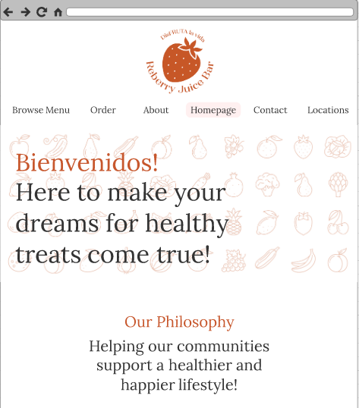
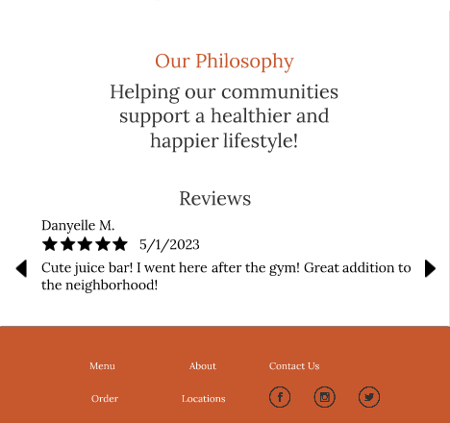
Wireframe #1: Homepage
Notes:
With these final high-fidelity wireframes, I became content with the flows of my content and navigation.. I was really conscious of how I incorporated the information architecture components to achieve both stakeholder and user needs. Overall I ensured to make my content organized, labeled, and incorporate a search system where necessary to ensure my users can navigate to the content they need efficiently. By avoiding overbearing them with information from navigation options to cont ent, I ensure they are not driven away from the site. Instead, I make sure the users can find the content and tasks they need to meet their information needs with satisfaction.
This is my first high fidelity wireframe, the website’s homepage.
The first navigation you can observe is the global navigation bar. I didn’t incorporate a distinctive placemakers as I did for other pages that navigate away from the homepage.
With my use of labels and organization, scrolling down this homepage introduces users to a welcoming message, the business’s motivations and reviews for them to gain an understanding of what they can expect from the Reberry Juice Bar

Slide 9
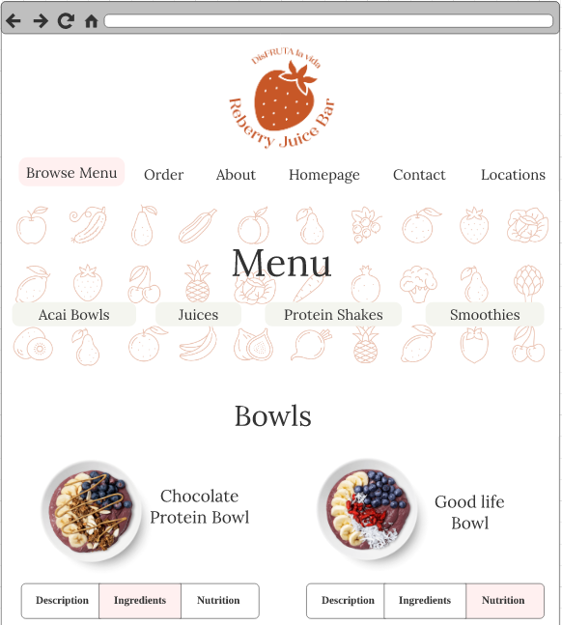
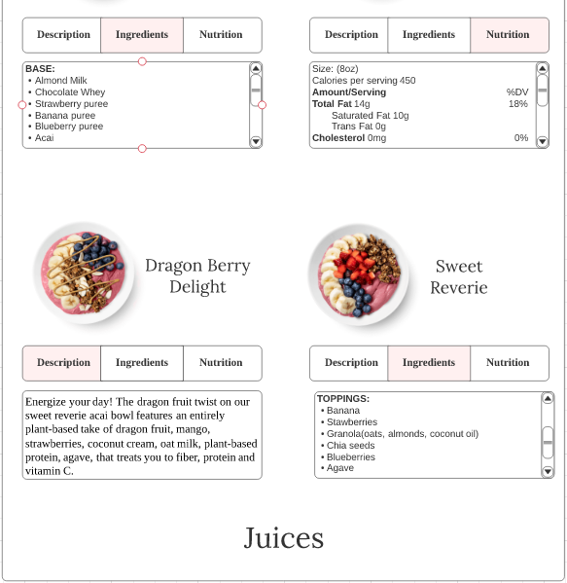
Wireframe #2: Browse Menu
Notes:
With the browse menu page, I was very careful of how I incorporated many components for all the information it contains.
As a user navigates away from the homepage, a distinctive placemaker becomes important. A heading for the selected page from the navigation bar, Menu, reminds the user of what page they are at. The global navigation / navigation bar is unchanged as it is intended to be consistent and on the top of every page.
There were several labeling systems here. The browse menu indicates to users they may view the menu items to browse and become acquainted with items that may peak their interest. There is local navigation with the contextual links organized by item category, like acai bowls and juices. This helps provide some navigation to a specific area among all the items available. No search bar is needed here as people tend to browse the menu not knowing an exact product they desire.
(There is a searching system incorporated in my ordering page, where customers are ready to order and more likely to want to access specific items. )
My organization here was critical. There was a lot of information for each item. It could be overbearing for users to see the description, ingredients, and nutrition of many items. By separating these three chunks of information with a shallow breadth of options, people can easily navigate to select what information they want to see for each item. Only would only take up to three clicks to navigate to this information from the homepage!

Slide 10
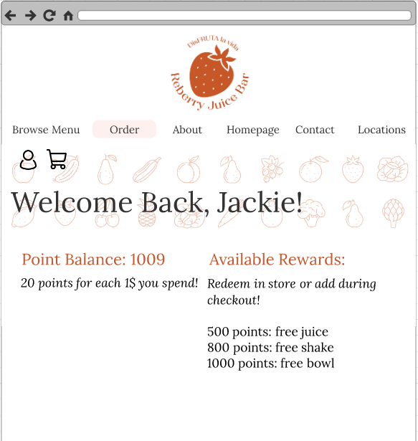
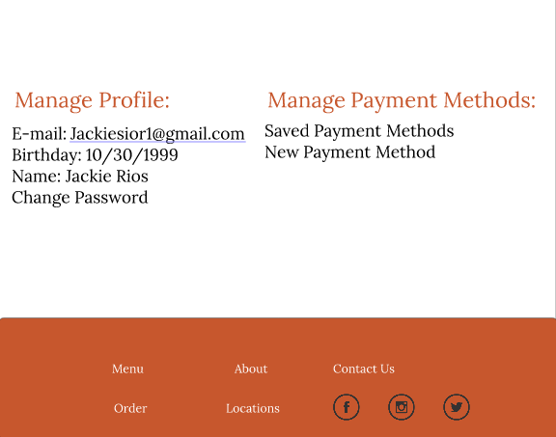
Wireframe #3: Rewards Account
Notes:
This is the rewards account to help incentivize and motivate returning customers.
A user navigates to this page by first clicking on the order page. Someone who has ordered or is wanting to order would access this page. From here, they see the local navigation with a task-oriented scheme with the icons. A user who has an account would navigate to their personal rewards account by clicking on the intuitive person icon.
I wanted to reduce the breadth of options to users from the navigation bar. Furthemore, putting the personal rewards account page and checking out page in the second level of the navigation hierarchy achieves this.
The page’s content is organized by tasks. A heading represents each of these tasks. One may want to view points and rewards, or manage personal information for their account. There are several labels that are navigation system choices here. They provide local navigation to an encrypted subsite for users to have comfort and security when changing sensitive information.

Slide 11
Issues and Lessons
Take your time to learn new applications
Don’t skip tutorials
Practice on my own time
Revise, revise, revise!
Can make so many improvements!
Review those notes
Notes:
Take your time to learn application.
Not skipping tutorial helps see if an application has the appropriate tools for you. Knowing how to use them will make it less confusing for you later.
Practicing on my own time would make me become more accustomed to these tools making my utilization of them more time efficient. The time can be used to be more creative and enhance my work!
Revise, revise, revise!
Do not be afraid to improve your wireframes, especially the low fidelity wireframes. It is important to not just settle with one or two version when you are unsure how you feel wit you information architecture. Ensure that flow!
Reviewing notes. Going over four components of information architecture made me feel more confident about where I was headed with my work.

Slide 12
Conclusion
Completing each page with diligence of the four components of information architecture, I ensure the mission of the website is fruitful!
It was surprising what I could achieve with my wireframes! Proudly going to my portfolio!
Notes:
Being mindful of Reberry Juice Bar’s mission and users needs helped ensure the necessary content is considered and incorporated into the site. Being able to distinguish the importance and aspect of each components provided comfort and great guidance with the designs and revisions. With the four components I managed to make an accessible platform that would satisfy potential users’ information needs.
Thankful for this opportunity to design this website. Proud of my work and look forward to adding it to my portfolio! A pleasure to have your guidance Dr. Reyes!

